Slide 1
RWD Day1 presented by: Asmaa Ahmed

Slide 2
Responsive Web Design - Introduction
What is Responsive Web Design?
Responsive web design makes your web page look good on all devices.
Responsive web design uses only HTML and CSS.
Responsive web design is not a program or a JavaScript.
\Think responsively .. Mobile first.
Mobile first design :Design for mobile then for desktop.

Slide 3
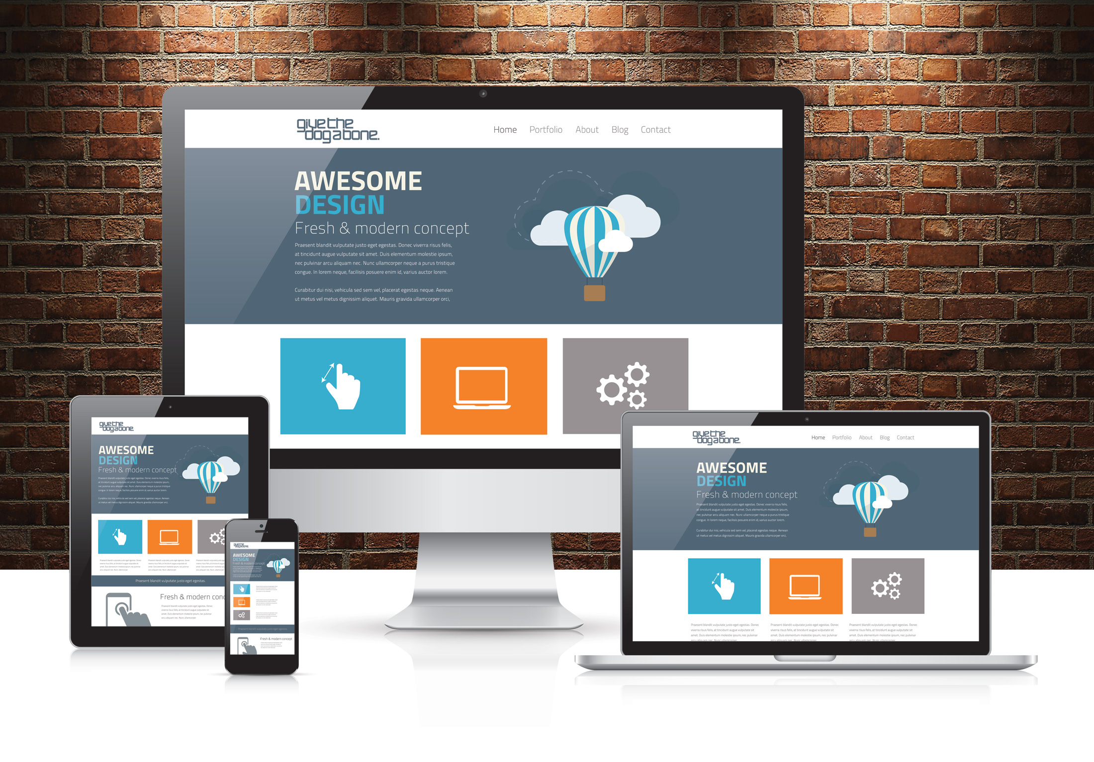
Responsive Web Design - Introduction

Slide 4
Responsive Web Design - Introduction
Designing For The Best Experience For All Users:
Web pages can be viewed using many different devices: desktops, tablets, and phones. Your web page should look good, and be easy to use, regardless of the device.
Web pages should not leave out information to fit smaller devices, but rather adapt its content to fit any device:

Slide 5
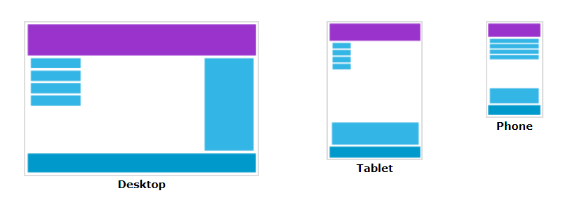
Responsive Web Design - Introduction

Slide 6
Responsive Web Design vs Adaptive Design
The difference between responsive design and adaptive design is that responsive design adapts the rendering of a single page version.
In contrast, adaptive design delivers multiple completely different versions of the same page.

Slide 7
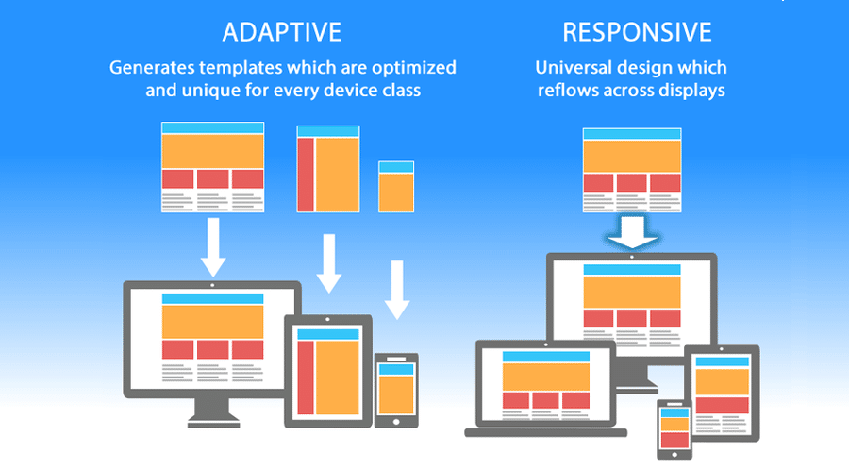
Responsive Web Design vs Adaptive Design

Slide 8
Guides to create responsive Website
Use Html5
Set the viewport
Size content to the viewport
Use Website layout
Use flexbox
Use Media Queries

Slide 9
Responsive Web Design - Viewport
What is The Viewport?
The viewport is the user's visible area of a web page.
The viewport varies with the device, and will be smaller on a mobile phone than on a computer screen.
Before tablets and mobile phones, web pages were designed only for computer screens, and it was common for web pages to have a static design and a fixed size.
Then, when we started surfing the internet using tablets and mobile phones, fixed size web pages were too large to fit the viewport. To fix this, browsers on those devices scaled down the entire web page to fit the screen.
This was not perfect!! But a quick fix.

Slide 10
Responsive Web Design - Viewport
Setting The Viewport:
HTML5 introduced a method to let web designers take control over the viewport, through the <meta> tag.
You should include the following <meta> viewport element in all your web pages:
<meta name="viewport" content="width=device-width, initial-scale=1.0">
This gives the browser instructions on how to control the page's dimensions and scaling.
The width=device-width part sets the width of the page to follow the screen-width of the device (which will vary depending on the device).
The initial-scale=1.0 part sets the initial zoom level when the page is first loaded by the browser.

Slide 11
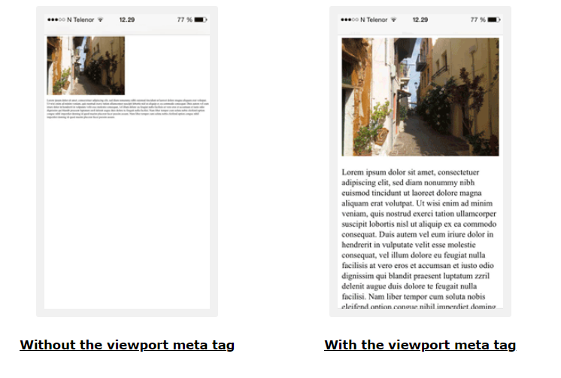
Responsive Web Design - Viewport

Slide 12
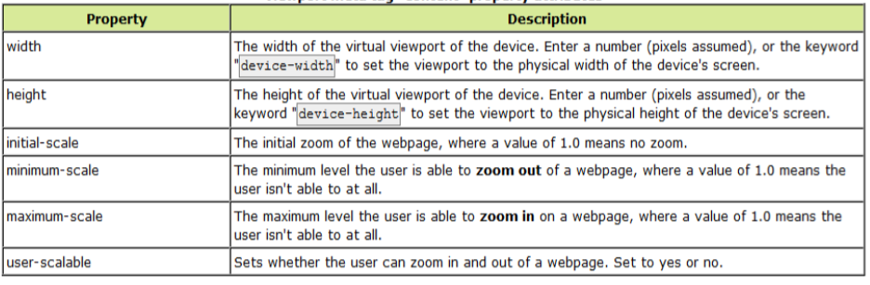
Responsive Web Design - Viewport

Slide 13
Size Content to The Viewport
Users are used to scroll websites vertically on both desktop and mobile devices - but not horizontally!
So, if the user is forced to scroll horizontally, or zoom out, to see the whole web page it results in a poor user experience.

Slide 14
Size Content to The Viewport
Some additional rules to follow:
1. Do NOT use large fixed width elements - For example, if an image is displayed at a width wider than the viewport it can cause the viewport to scroll horizontally. Remember to adjust this content to fit within the width of the viewport.
2. Do NOT let the content rely on a particular viewport width to render well - Since screen dimensions and width in CSS pixels vary widely between devices, content should not rely on a particular viewport width to render well.
3. Use CSS media queries to apply different styling for small and large screens - Setting large absolute CSS widths for page elements will cause the element to be too wide for the viewport on a smaller device. Instead, consider using relative width values, such as width: 100%. Also, be careful of using large absolute positioning values. It may cause the element to fall outside the viewport on small devices.

Slide 15
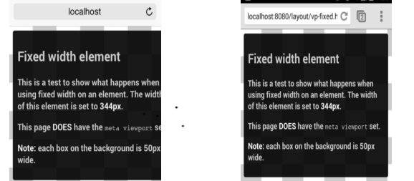
Size Content to The Viewport

Slide 16
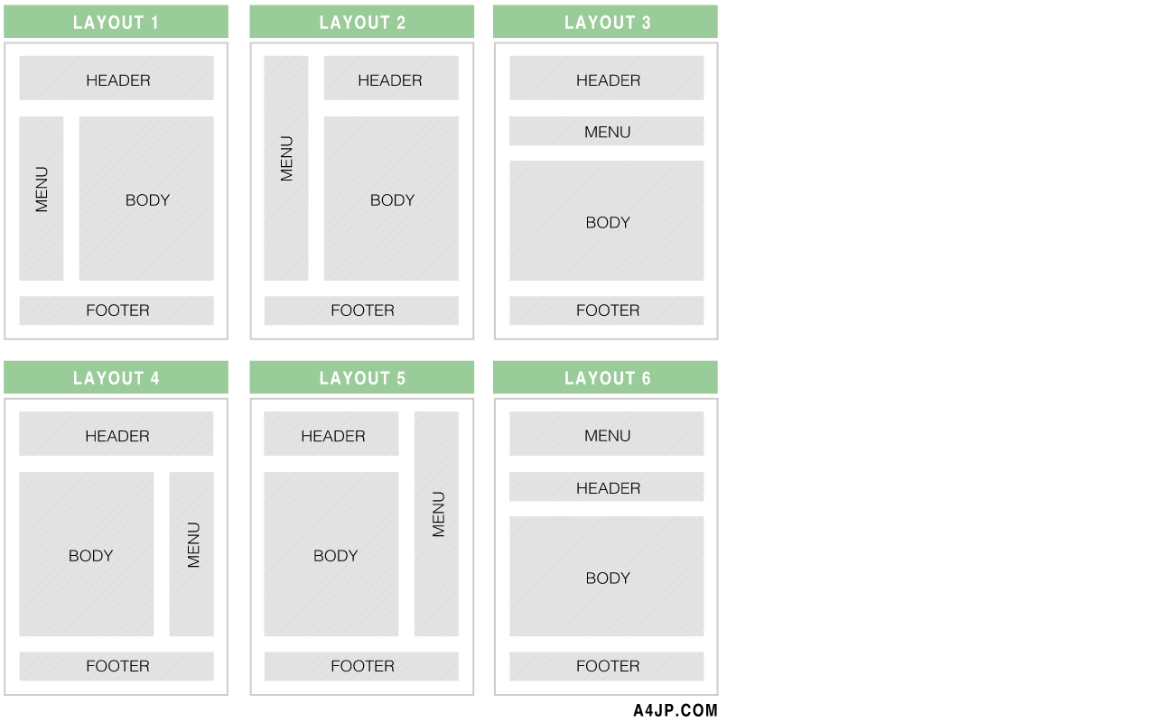
Website Layout

Slide 17
CSS FlexBox
This defines a flex container; inline or block depending on the given value. It enables a flex context for all its direct children.

Slide 18
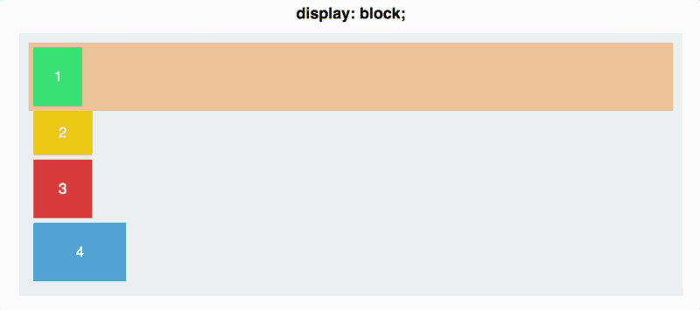
Property #1:
Display: block;

Slide 19
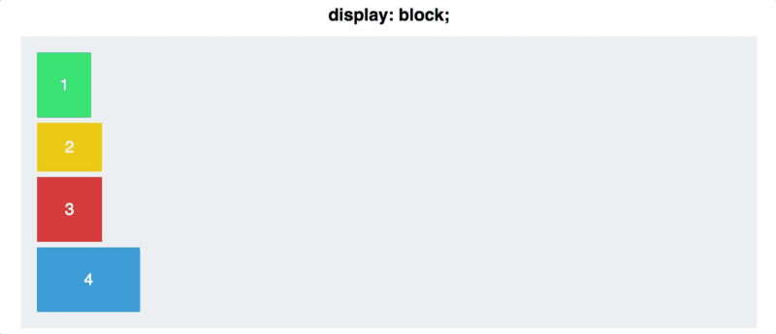
Property #1:
Display: flex;

Slide 20
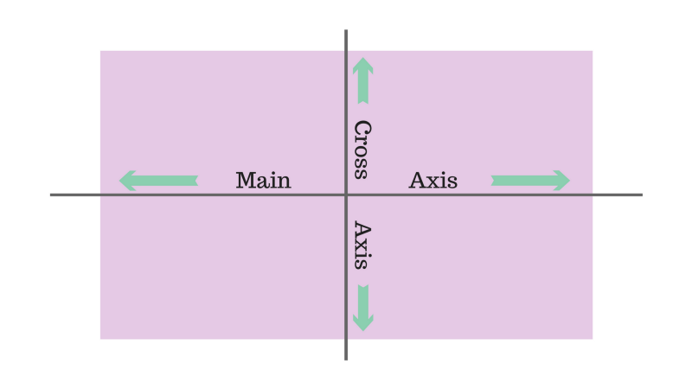
Property #2: Flex Direction
By default, items are arranged along the main axis, from left to right. This is why your squares defaulted to a horizontal line once you applied display: flex;
#container { display: flex; flex-direction: column;}

Slide 21
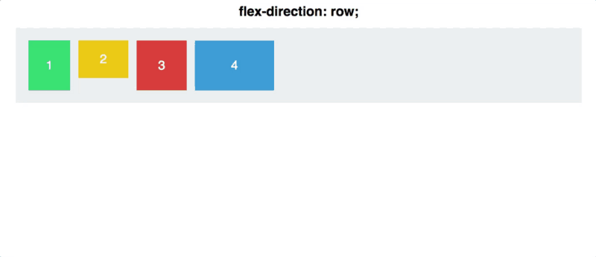
Property #2: Flex Direction
#container { display: flex; flex-direction: column | row;}

Slide 22
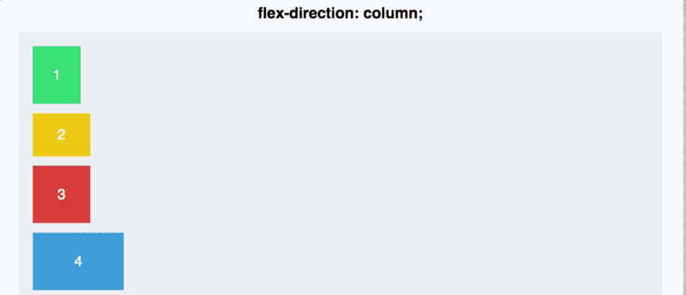
Property #2: Flex Direction
There are a couple of other options for flex-direction, as well: row-reverse and column-reverse.

Slide 23
Property #3: Justify Content
Justify-content controls how you align items on the main axis.
#container { display: flex; flex-direction: row; justify-content: flex-start;}
You have five commands at your disposal to use justify-content:
Flex-start
Flex-end
Center
Space-between
Space-around

Slide 24
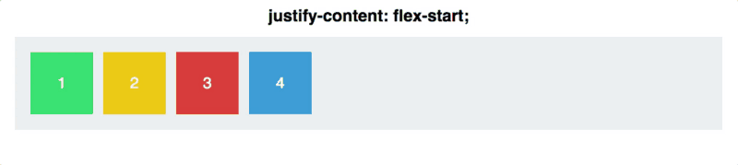
Property #3: Justify Content
Justify-content controls how you align items on the main axis.

Slide 25
Property #4: Align Items
As justify-content works along the main axis, align-items applies to the cross axis.

Slide 26
Property #4: Align Items
Then, let’s dive into the align-items commands.
flex-start
flex-end
center
stretch
baseline

Slide 27
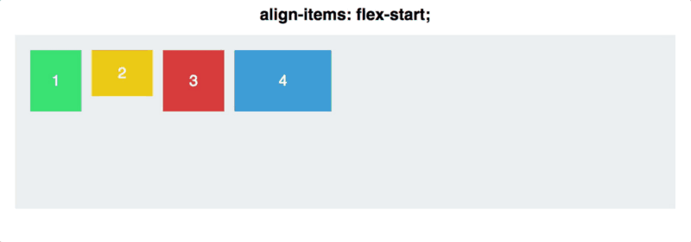
Property #4: Align Items

Slide 28

Property #4: Align Items

Slide 29
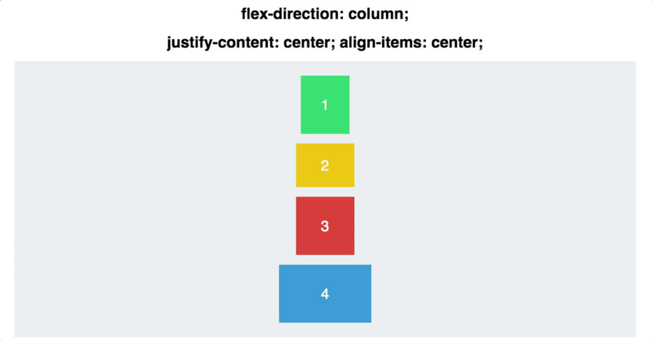
Property #4: Align Items

Slide 30
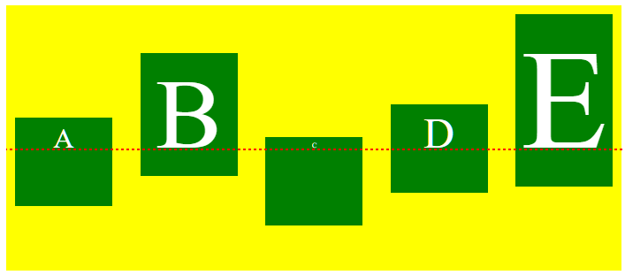
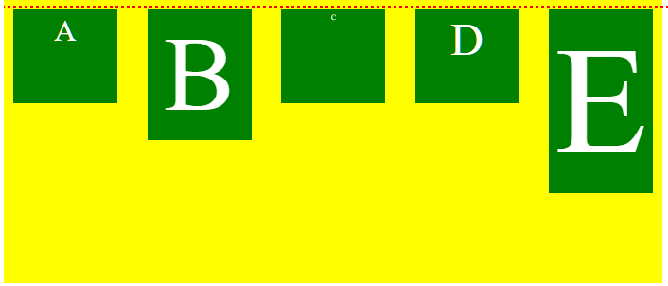
Difference between flex-start &Baseline at Align Items property
Baseline
Flex-start

Slide 31
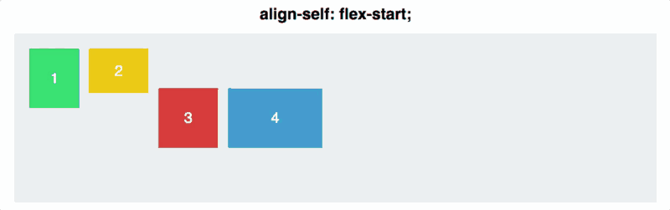
Property #5: Align Self
Align-self allows you to manually manipulate the alignment of one particular element.
.square#one { align-self: center;}// Only this square will be centered.

Slide 32
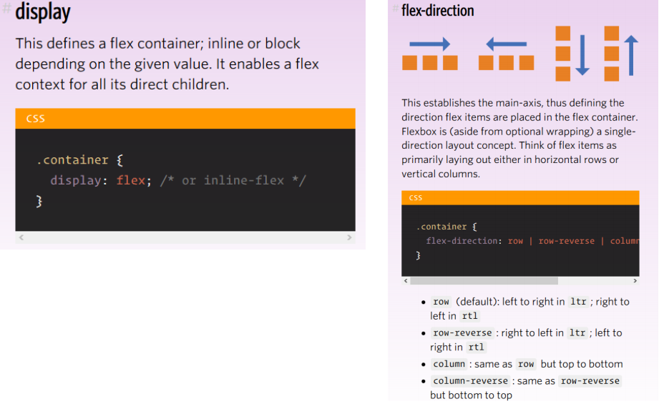
CSS FlexBox

Slide 33
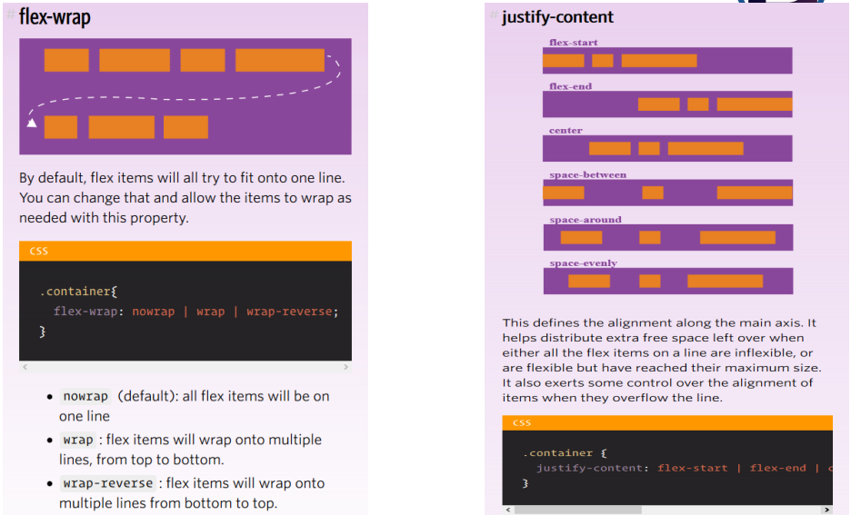

Slide 34
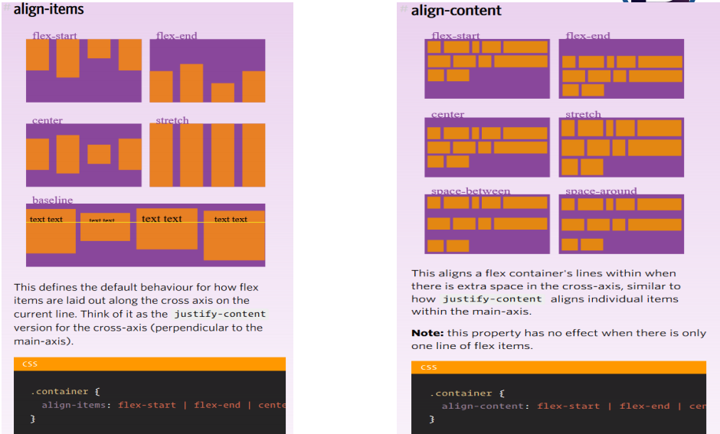
CSS FlexBox

Slide 35
CSS Flexbox Resources
https://css-tricks.com/snippets/css/a-guide-to-flexbox/
https://www.w3schools.com/css/css3_flexbox.asp

Slide 36
Responsive Web Design - Media Queries
What is a Media Query?
Media query is a CSS technique introduced in CSS3.
It uses the @media rule to include a block of CSS properties only if a certain condition is true.

Slide 37
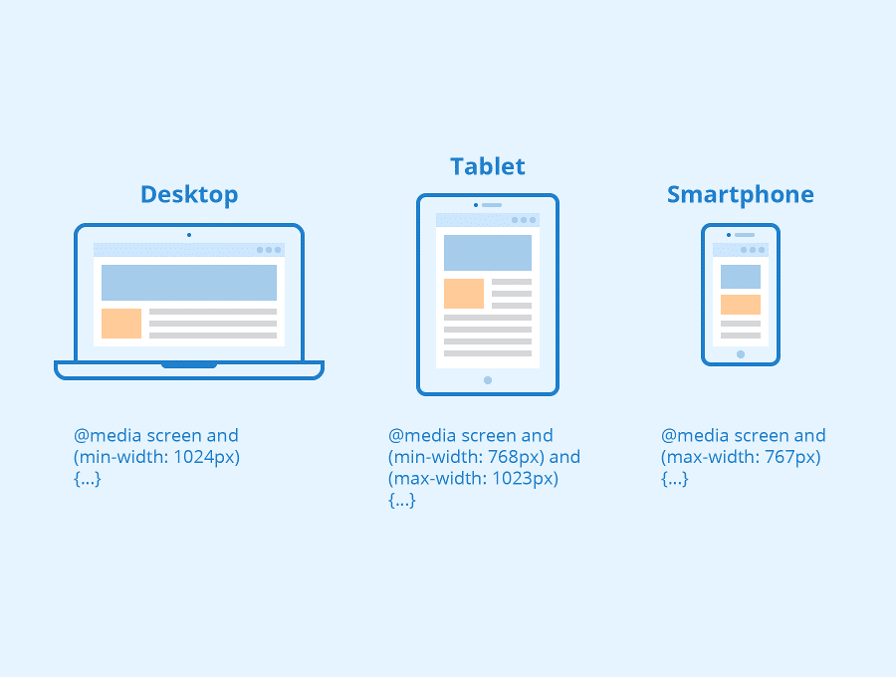
Responsive Web Design - Media Queries

Slide 38
Common Responsive Breakpoints
To work with media queries, you need to decide on the “responsive breakpoints” or screen size breakpoints. A breakpoint is the width of the screen where you use a media query to implement new CSS styles.
Common screen sizes:
Mobile: 360 x 640
Mobile: 375 x 667
Mobile: 360 x 720
iPhone X: 375 x 812
Pixel 2: 411 x 731
Tablet: 768 x 1024
Laptop: 1366 x 768
High-res laptop or desktop: 1920 x 1080

Slide 39
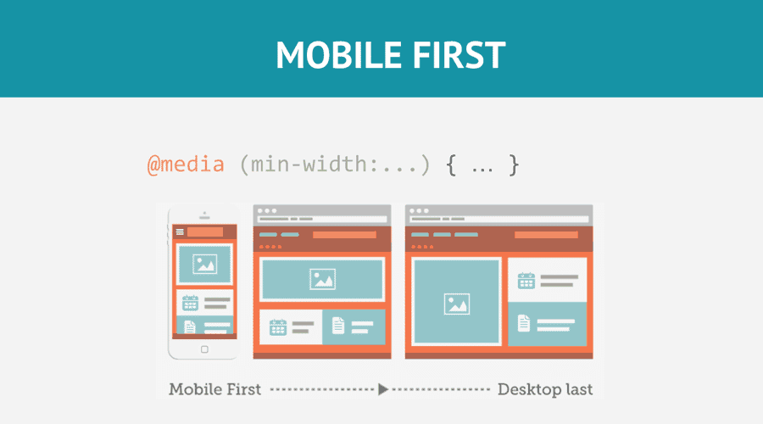
Responsive Web Design - Media Queries

Slide 40
Common Responsive Breakpoints
Set Your Media Query Ranges (Responsive Breakpoints):
Set your media query ranges based on the unique needs of your design. For example, if we wanted to follow the Bootstrap standards for our design, we would use the following media queries:
576px for portrait phones
768px for tablets
992px for laptops
1200px for large devices

Slide 41
CSS Units and Values for Responsive Design
CSS has both absolute and relative units of measurement. An example of an absolute unit of length is a cm or a px. Relative units or dynamic values depend on the size and resolution of the screen or the font sizes of the root element.

Slide 42
CSS Units and Values for Responsive Design
PX vs EM vs REM vs Viewport Units for responsive design
PX – a single pixel
EM – relative unit based on the font-size of the element.
REM – relative unit based on the font-size of the element.
VH, VW – % of the viewport’s height or width.
% – the percentage of the parent element.
A new web designer or developer should probably stick with pixels for text because they are the most straight-forward unit of length in CSS.
But when setting the width and max-width of images and other elements, using % is the best solution. This approach will make sure the components adjust to the screen size of every device.

Slide 43
Responsive Web Design Patterns
Responsive web design patterns are quickly evolving, but there are a handful of established patterns that work well across the desktop and mobile devices.
Most layouts used by responsive web pages can be categorized into one of five patterns: mostly fluid, column drop, layout shifter, tiny tweaks, and off canvas.

Slide 44
Thanks!
Any questions?

